Slide 1
Client/Server Architecture

Slide 2
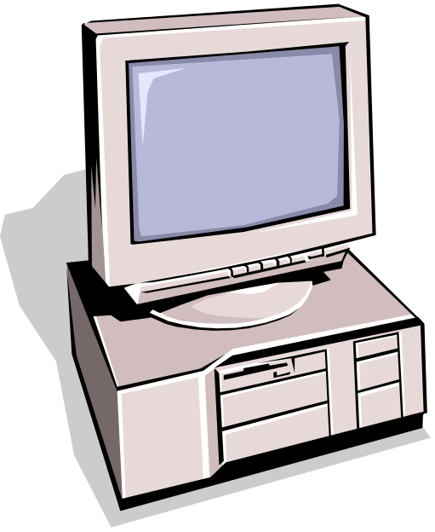
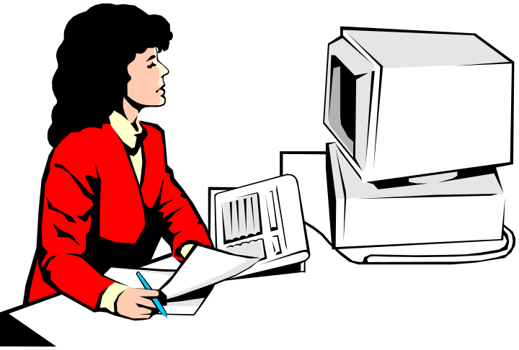
Components
Clients
Servers
Communication Networks
Server
Client

Slide 3
Clients
Applications that run on computers
Rely on servers for
  Files
  Devices
  Processing power
Example: E-mail client
  An application that enables you to send and receive e-mail
Clients are Applications

Slide 4
Servers
Computers or processes that manage network resources
  Disk drives (file servers)
  Printers (print servers)
  Network traffic (network servers)
Example: Database Server
  A computer system that processes database queries
Servers Manage Resources

Slide 5
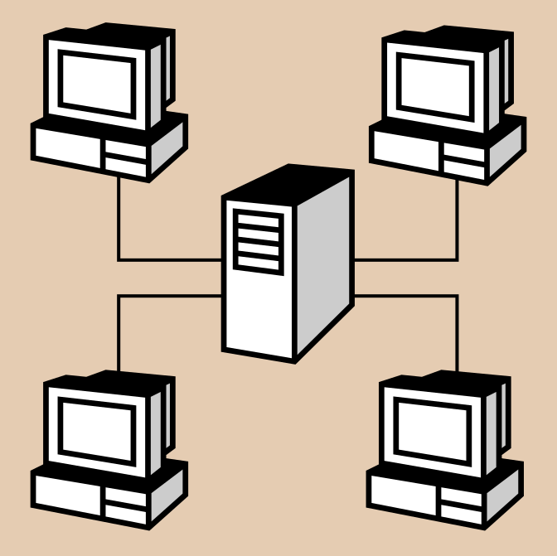


Communication Networks
Networks Connect Clients and Servers

Slide 6
Client–Server Computing
Process takes place
  on the server and
  on the client
Servers
  Store and protect data
  Process requests from clients
Clients
  Make requests
  Format data on the desktop
Client-Server Computing Optimizes Computing Resources

Slide 7
Application Functions
Software application functions are separated into three distinct parts
Server:
Data Management
Client: Presentation & Application Logic

Slide 8
Application Components
3
Data Management
2 Client Types
2
Application Logic
Fat
Client
1
Presentation
Thin
Client
3 Logical Tiers
Database Applications:
  Most common use of client-server architectures

Slide 9
Client/Server Computing
Client machines are generally single-user PCs or workstations that provide a highly user-friendly interface to the end user
The server enables many clients to share access to the same database and enables the use of a high-performance computer system to manage the database
Each server provides a set of shared user services to the clients

Slide 10
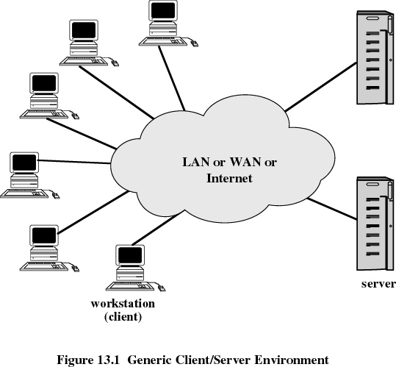

Slide 11
Client/Server Applications
Basic software is an operating system running on the hardware platform
Platforms and the operating systems of client and server may differ
These lower-level differences are irrelevant as long as a client and server share the same communications protocols and support the same applications

Slide 12
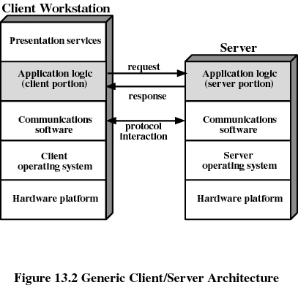

Slide 13
Client/Server Applications
Actual functions performed by the application can be split up between client and server
Optimize platform and network resources
Optimize the ability of users to perform various tasks
Optimize the ability to cooperate with one another using shared resources

Slide 14
Database Applications
The server is a database server
Interaction between client and server is in the form of transactions
  the client makes a database request and receives a database response
Server is responsible for maintaining the database

Slide 15
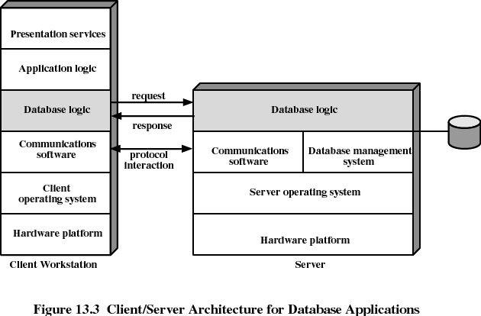

Slide 16
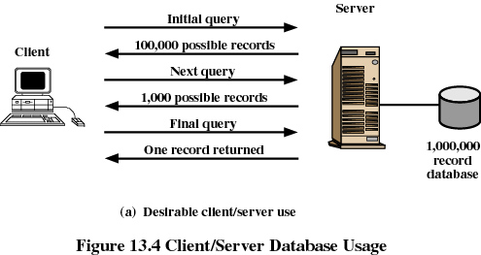

Slide 17
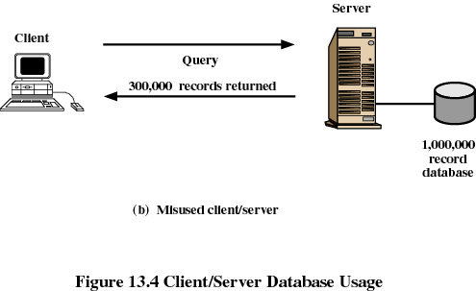

Slide 18
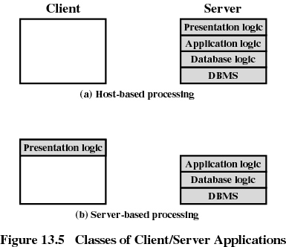
Classes of Client/Server Applications
Host-based processing
  not true client/server computing
  traditional mainframe environment

Slide 19
Classes of Client/Server Applications
Server-based processing
  server does all the processing
  user workstation provides a graphical user interface

Slide 20
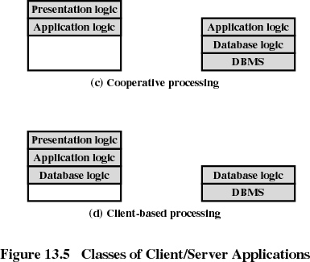
Classes of Client/Server Applications
Client-based processing
  all application processing done at the client
  data validation routines and other database logic function are done at the server

Slide 21
Classes of Client/Server Applications
Cooperative processing
  application processing is performed in an optimized fashion
  complex to set up and maintain

Slide 22
Examples of Client Server Apps
Client/Server model of computing is widely used in many applications in today’s computing environment.
Common examples that everybody might have interacted are:
  Email Applications
  Chat applications

Slide 23


Email application
Server
Client
Client
Email client sends message to server
Later, recipient’s email client retrieves message from server
Message is stored on POP server

Slide 24
Chat application
Server
Client
Client
Chat server aggregates typing from all users and sends to all clients
Other user’s clients display aggregated typing from chat server
Chat clients send user’s typing to server

Slide 25
Three-Tier Client/Server Architecture

Slide 26
Tiered Architectures
System
  A group of interrelated elements forming a collective entity
Architecture
  A style and method of design and construction

Slide 27
An architectural history of computing
1 tier architecture
  monolithic Information Systems
  presentation, application logic, and resource management were merged into a single tier
2 tier architecture
  separation of presentation tier from other 2 tiers (app + resource)
  became popular as 'client/server' systems
3 tier architecture
  can be achieved by separating RM (resource management) from application logic tier

Slide 28
Three-Tier Client/Server Architecture
Application software distributed among three types of machines
  User machine
    thin client
  Middle-tier server
    Gateway
    Convert protocols
    Merge/integrate results from different data sources
  Backend server

Slide 29
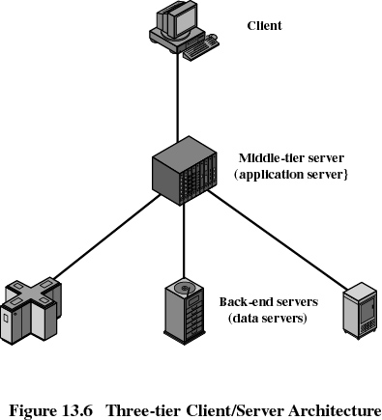

Slide 30

Tiers of an architecture
Client
browser
Presentation
tier
<html>
...
</html>
Visualise
Application
logic tier
information system
Calculate
Resource
management tier
Store

Slide 31
Presentation Tier
Any IS needs to communicate with external entities, human users or other computers
Allows these entities to interact with the system
Implemented as a GUI interface
Referred to as the client of the IS – which is not correct
Example:
  Systems accessed by web browsers using plain HTML documents
  The client is a web browser that only displays information prepared by the Web server
  The presentation layer in this case is the Web server
How the data should appear to the user and how the user should interact with the interface

Slide 32
Application Logic Tier
IS do more than information delivery, they perform data processing (Business Logic & calculation) behind the results being delivered
Example:
  A program that implements a withdrawal operation from a bank
  This program takes the request, checks whether there is enough funds, verifies whether withdrawal limits are exceeded, creates a log entry for the operation, performs the operations against the current balance and gives approval for handing out the money.
  Here the algorithms are implemented
This tier is often referred to as
  Services
  Business logic
  Business rules
  Server

Slide 33
Resource Management Layer
IS needs data to work with
Data can reside in databases or other information repositories
Deals with and implements different data sources of Information Systems
Also referred to as the data layer, which indicates that it is implemented using a Database Management System
From the banking example:
  The RM layer could be the account database of the bank
Can also be a gateway to recursively using other ISs

Slide 34
1 – Tier Architectures
Mainframe-based and the system took place through dumb terminals
Monolithic Information Systems
Presentation, application logic, and resource management were merged into a single tier
Many of these 'old' Systems are still in use!
Due to its monolithic nature it did not provide an entry point from the outside except the channel to the dumb terminals
Considered as ‘black box’

Slide 35
Design of 1 – Tier Architecture
Advantages:
easy to optimise performance
no context switching
no compatibility issues
no client developement, maintainance and deployment cost
Disadvantages:
monolithic pieces of code (high maintainance)
hard to modify – lack of documentation and qualified programmers
lack of qualified programmers for these systems
Client
Presentation
layer
Application
logic layer
information system
Resource
management layer

Slide 36
2 - Tier Architectures
Client
fig 1.7 p.12
Information system
Resource management layer

Slide 37
2 - Tier Architectures
Coming of PC was the real push to 2-tier architectures
Separation of presentation layer from other 2 layers (app + resource)
  Client/server systems with thin clients/fat clients
  Use RPC (Remote Procedure Call) to communicate between tiers
  Need for standardisation for inter-tier communication
Advantages
  portability
  no need for context switches or calls between component for key operations
Disadvantages
  limited scalability
  legacy problems (blown up clients)

Slide 38
3 - Tier Architectures
client
presentation
layer
application logic layer
middleware
information system
resource management layer

Slide 39
3 - Tier Architectures
The former created islands of information where a set of clients could communicate with a server but not with other servers
3-tier made it technically possible to integrate different servers
Separating RM (resource management) from application logic layer
  Additional middleware layer between client and server
    integration logic
    application logic
Lead to the introduction of clear RM layer interfaces
Good at dealing with integration of different resources

Slide 40
3 - Tier Architectures
Advantages
  scalability by running each layer on a different server
  scalability by distributing AL (application logic layer) across many nodes
  additional tier for integration logic
  Flexibility
Disadvantages
  performance loss if distributed over the internet
  problem when integrating different 3 – tier systems

Slide 41
3 - tier Architectures
client
GUI clients
C++, VB, Java
presentation
layer
application logic layer
Middleware
Server
middleware
information system
Databases
resource management layer
Legacy Systems

Slide 42
Middleware
Middleware refers to the software which is common to multiple applications and builds on the network transport services to enable ready development of new applications and network services.

Slide 43
Middleware
Software that connects two otherwise separate applications
Example: Middleware product linking a database system to a Web server
Database Server:
Manages Data
Middleware Links Applications
Web Server:
Presents Dynamic Pages
Client: Requests Data via Web

